Slide 1

Sales Forecast
Bryn is working with the purchasing team to revise the sales forecast for the year 2018. Based on the information given, create this forecast using your preferred method.

Slide 2
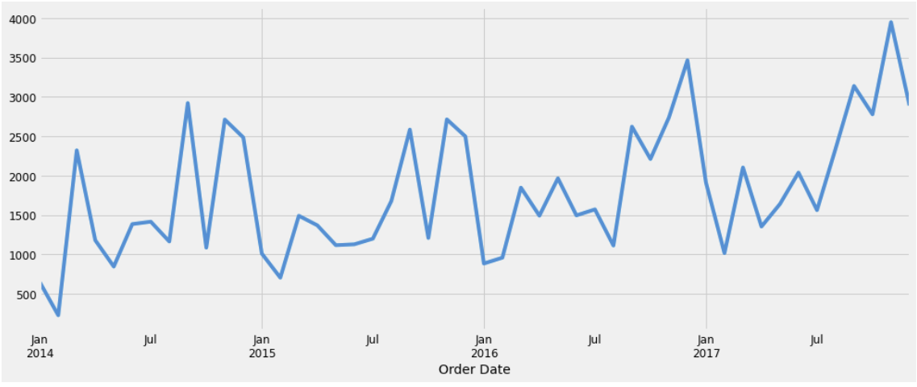
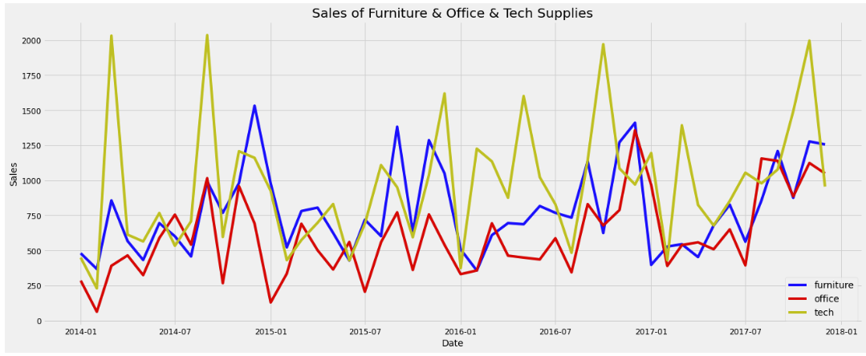
Superstore Sales tend to be higher at the end of the year
Superstore Sales Per Month from Jan 2014 to Nov 2017
We detect some seasonality in the superstore data with lower sales at the beginning of the year and higher at the end. There is an uptrend in any single year.
We can notice the tech products have higher sales and also very high periods of demand compared to other products.

Slide 3
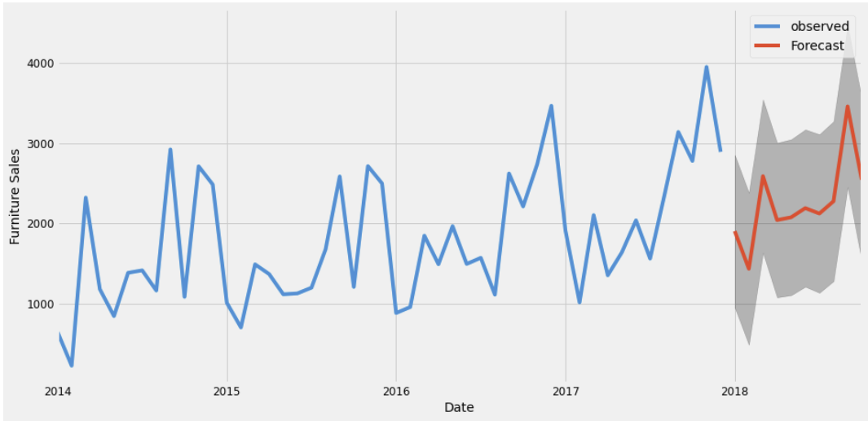
Superstore Sales will continue with similar up-trend
Forecast of Superstore Sales For Jan - Dec 2018
According to the forecast, we expect sales to follow a similar trend with higher sales at the end of the year. We will see a slow growth in sales compared to 2017. Though, average sales at the beginning of the year is expected to be higher.
The model validation results were strong. The forecast for 2017 was pretty similar to the observed values (see appendix).
MSE: 20098.5 - RMSE: 448.26 - MAPE: 82.53%
Model: SARIMAX (1,1,1)(0,1,1,12) - AIC: 283.37

Slide 4
Additional data to improve Superstore Forecast
Forecast of Superstore Sales For Jan - Dec 2018
Additional Data:
Inventory data
Customer data (feedback, reviews)
Operational data (store traffic, product placement)
Market trends (GDP, unemployment rate)
External factors (holidays, weather)
In the future, I would consider forecasting sales per category to have a more robust model. In addition, trying other methodologies would be my next step.
MSE: 20098.5 - RMSE: 448.26 - MAPE: 82.53%
Model: SARIMAX (1,1,1)(0,1,1,12) - AIC: 283.37

